Slide 1

APPLICATION OF GAME THEORY IN NETWORK SECURITY DEFENSE
CSD4003: NETWORK AND SYSTEM SECURITY
Ananya Das 21MEI10033
Pranav Pradeep Menon 21MEI10039

Slide 2
INTRODUCTION TO GAME THEORY IN NETWORK SECURITY
Game theory applies mathematical models to analyze strategic interactions between attackers and defenders.
Relevance: With increasing cyber threats, game theory helps design effective security strategies to anticipate, mitigate, and respond to cyberattacks.
Importance: Given the complexity and frequency of cyber threats, game-theoretic models optimize cybersecurity defense strategies across various sectors.

Slide 3
SALIENT FEATURES
1
Strategies: Predetermined plans of action based on anticipated opponent moves.
Payoffs: Rewards or penalties resulting from actions in the game.
Equilibrium: Optimal strategies for both players.
2
3
Types of Games:
Non-Cooperative Games: Players (attackers and defenders) act independently.
Cooperative Games: Players can form alliances to improve defense strategies.
Zero-Sum Games: One player’s gain is the other’s loss (relevant in cybersecurity).

Slide 4


TYPES OF GAMES IN NETWORK SECURITY
STATIC VS. DYNAMIC GAMES
REPEATED GAMES
MIXED STRATEGIES
Static: One-time decisions, no future interaction (e.g., one-time attack).
Dynamic: Sequential decisions, multiple stages (e.g., ongoing threats and adaptations).
Long-term interactions allowing players to adjust strategies based on past behavior.
Players randomize actions to make strategies unpredictable (e.g., varying defense techniques).

Slide 5
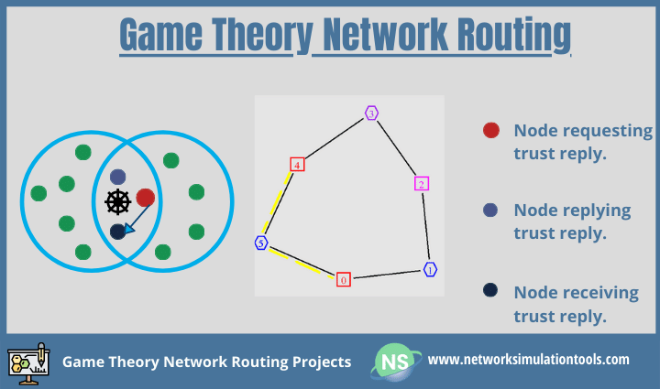

Slide 6
PRACTICAL APPLICATIONS
INTRUSION DETECTION SYSTEMS (IDS)
DENIAL OF SERVICE (DOS) MITIGATIONS)
THREAT HUNTING
Game theory aids in optimizing IDS by assessing attacker behavior and defending strategies.
Game-theoretic models help defenders predict and neutralize threats proactively.
Game theory models help develop countermeasures for DoS attacks in wireless networks.

Slide 7

CASE STUDIES
COOPERATIVE GAME THEORY FOR RESOURCE ALLOCATION
MIXED STRATEGIES IN SECURITY PROTOCOLS
BEHAVIORAL GAME THEORY IN CYBERSECURITY

Slide 8
CHALLENGES AND LIMITATIONS
Modeling Player Behavior
Computational Demands
Psychological Factors
Incomplete Information

Slide 9
FUTURE SCOPE
Game Theory and Machine Learning
Dynamic Adaptation and Enhanced Defense System

Slide 10
THANK
YOU

